Slide 1
Happy wedding
Submitted by:
FATHIMA ZAYYINA

Slide 2
Contents
Abstract
Modules
Familiarization with build tools
GIT
NETBEANS
Bugzilla
EXISTING SYSTEM
PROPOSED SYSTEM
Table Design
UML DIAGRAMS
Forms

Slide 3
abstract
The objective of the project is to develop a system online matrimonial application is in the process of interconnecting all the branches and to develop a custom-made software which covers functions like matrimonial management and processing of a matrimonial agency. The system not only takes care of registration but also contemplate on workflow, customer service, customer history, employee history (both work history and payment history) and near paperless operation

Slide 4
Module description
1. ADMIN: Admin manages site and has the full power to add or remove the user.
Manage posted content
View comments
View ratings
Manage Category
Sent notifications

Slide 5
2. USER:
Provide email configuration after the completion of the project
Post profile scenario
Provide payment
Provide feedback
Provide chat
View posted contents
Rate posted content

Slide 6
Familiarization with build tools
The building tools are :
Net beans
GIT hub
The JAVA community is provided a few option including NetBeans and the long time font runner the eclipse IDE. The eclipse has lost some of its market share over the years to intel.

Slide 7
1. NetBeans
NetBeans is just an IDE.
They are entire platform net beans describe itself as an IDE that lets you quickly and easily develop java desktop, mobile and web application as well as HTML5 application with HTML.
It’s a great tool for large scale projects and makes it easier to bring on new developer because its structure is visible.
Net beans is module driven-everything in net beans happen via modules, which power and extends all its functionalities.
They are reusable.
It is excellent for converting to JAVA8.

Slide 8
2. Git hub
GIT is a version control system (Version control is a system that manages changes to a file or files).
Git is a VCS developed by Linux.
Its originally designed to help manage the LINUX kernel and make collaboration easy from the beginning.
GitHub is the most easy way to share project with collaborators.
This is extremely useful, especially when working in teams .

Slide 9
BUGZILLA
Bugzilla is an open-source issue/bug tracking system that allows developers effectively to keep track of outstanding problems with their product.
It is written in Perl and uses MYSQL database.
Bugzilla is a defect tracking tool, however it can be used as a test management tool as such it can be easily linked with other test case management tools like quality center, test link etc.
This open bug-tracker enables users to stay connected with their clients or employees, to communicate about problems effectively throughout the data-management chain.

Slide 10
Key features of Bugzilla includes:
Advanced search capabilities
E-mail notifications
Modify/file bugs by e-mail
Time tracking
Strong security
Customization
Localization

Slide 11
Existing System
When Manual System Is Used To Run The Happy Wedding Matrimonial System More Man Power Is Required.The Time Required To Check And Access Any Of Information Is Quite High Compared To The Computerized Matrimonial System.It Also Lacks To Maintain The Records.The Overall Computerized Processing Can Be Handled Accruately And Efficiency Compared In Manual System.

Slide 12
Proposed System
The main objective of this project is to help people in searching for their life partner.
To show detailed information of the person regarding his/her basic info, education details, life style details etc.
To fulfil the need of the individual which cannot need find their life partners. And to provide
Easy way of finding and entering information of the person

Slide 13
TABLES
Table 1: tbl LOGIN
Primarykey:Profile_id
Fields | Data Type | Constraints | Description
Profilefor_id | integer | Primary Key | Profile id
Profile _Name | Varchar | Not null | Profile Name

Slide 14
Table2: tbl_Religion
Primarykey:Religion_id
Fields | Data Type | Constraints | Description
Religion_id | integer | Primary Key | Religion id
Religion_ Name | Varchar | Not null | Religion Name

Slide 15
Table3: tbl_Education_Section
Primary key:Edu_id
Fields | Data Type | Constraints | Description
Edu_id | integer | Primary Key | Education id
Edu _Name | Varchar | Not null | Education name

Slide 16
Table4: tbl_Course
Primary key:Course_id
Fields | Data Type | Constraints | Description
Course _id | integer | Primary Key | Course id
Edu_id | integer | Foriegn Key | Education id
Course_ Name | Varchar | Not null | Course name

Slide 17
5.table5: tbl_Cast
Primary key:Cast_id
Fields | Data Type | Constraints | Description
Cast_id | integer | Primary Key | Cast id
Religion_id | integer | Primary Key | Religion id
Cast Name | Varchar | Not null | Cast name

Slide 18
Table6: tbl_Occupation
Primarykey:Occupation_id
Fields | Data Type | Constraints | Description
Occupation_id | integer | Primary Key | Occupation id
Occupatio_ Name | Varchar | Not null | Occupation name

Slide 19
Table7: tbl_City
Primarykey:City_id
Fields | Data Type | Constraints | Description
City_id | integer | Primary Key | City id
City Name | Varchar | Not null | City name

Slide 20
Table8: tbl_Aboutme
Primarykey:aboutme id
Fields | Data Type | Constraints | Description
Aboutme_id | integer | Primary Key | Aboutme id
User_id | integer | Foriegn Key | User id
Description | Varchar | Not null | Description

Slide 21
Table9: tbl_Basicfor
Primarykey:Basicfor_id
Fields | Data Type | Constraints | Description
Basicfor_id | integer | Primary Key | Basic for
User_id | integer | Foriegn Key | User id
Body Type | Varchar | Not null | Body type
Weight | Varchar | Not null | Weight

Slide 22
Table10: tbl_Lifestyle
primarykey:lifestyle_id
Fields | Data Type | Constraints | Description
Lifestyle_id | integer | Primary Key | Lifestyle id
Eating Habit | Varchar | Not null | Eating habit
Drinking Habit | Varchar | Not null | Drinking habit
Smoking Habit | Varchar | Not null | Smoking Habit

Slide 23
Table11: tbl_Familyinfo
Primarykey: Familyinfo_id
Fields | Data Type | Constraints | Description
Familyinfo_id | integer | Primary Key | Familyinfo id
Father Status | Varchar | Not null | Father Status
Mother Status | Varchar | Not null | Mother Status
Brother | Varchar | Not null | Brother
Sister | Varchar | Not null | Sister
Family | Varchar | Not null | Family
Location | Varchar | Not null | Location
Contact no | Varchar | Not null | Contact no

Slide 24
Table12: tbl_Partnerpreference
Primarykey: user_id
Fields | Data Type | Constraints | Description
User_id | integer | Primary Key | User id
Martial Status | Varchar | Not null | Martial Status
Height | Varchar | Not null | Height
Weight | Varchar | Not null | Weight
Family Status | Varchar | Not null | Family Status
Family Type | Varchar | Not null | Family Type

Slide 25
Table12: tbl_Login
Primarykey: user_id
Fields | Data Type | Constraints | Description
User_id | integer | Primary Key | User_id
Email | Varchar | Not null | Email
Password | Varchar | Not null | Password
Reg1 | Boolean | Not null | Registration1
Reg2 | Boolean | Not null | Registration2
Reg3 | Boolean | Not null | Registration3

Slide 26
Table13: tbl_Account_payment Primarykey: user_id
Fields | Data Type | Constraints | Description
name | varchar | Primary Key | name
address | Varchar | Not null | address
Account no | Varchar | Not null | Account no
Card no | varchar | Not null | Card no
cvv | varchar | Not null | cvv
Transaction password | varchar | Not null | Transaction password
balance | Decimal | Not null | balance

Slide 27
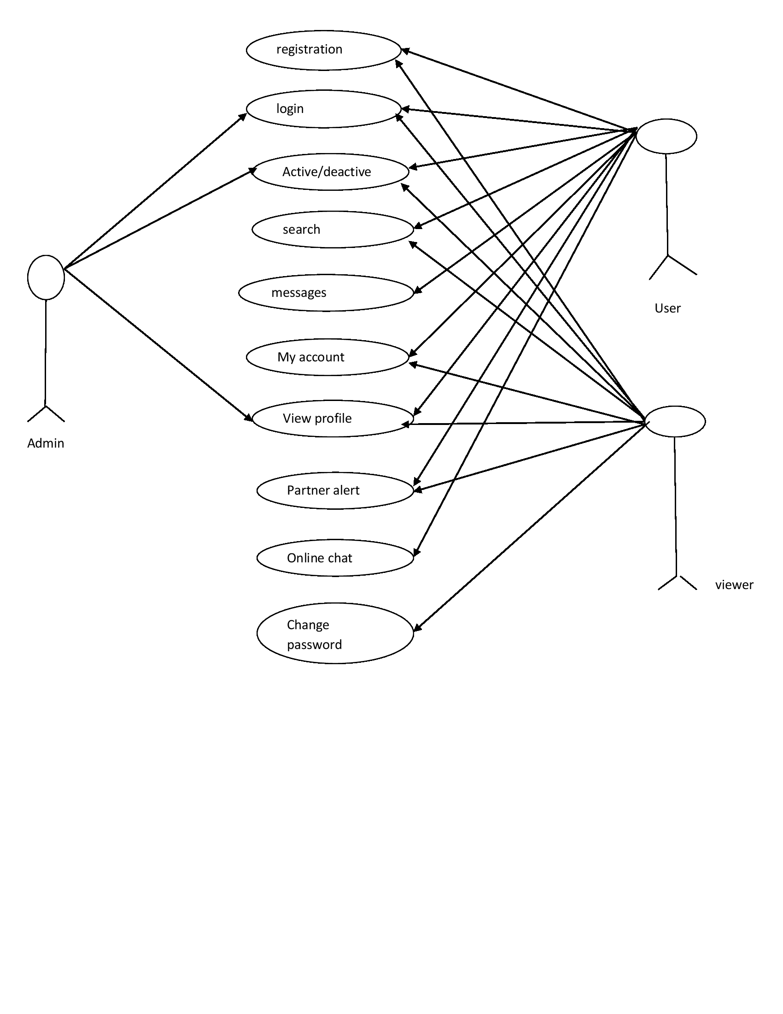
Use case diagram

Slide 28
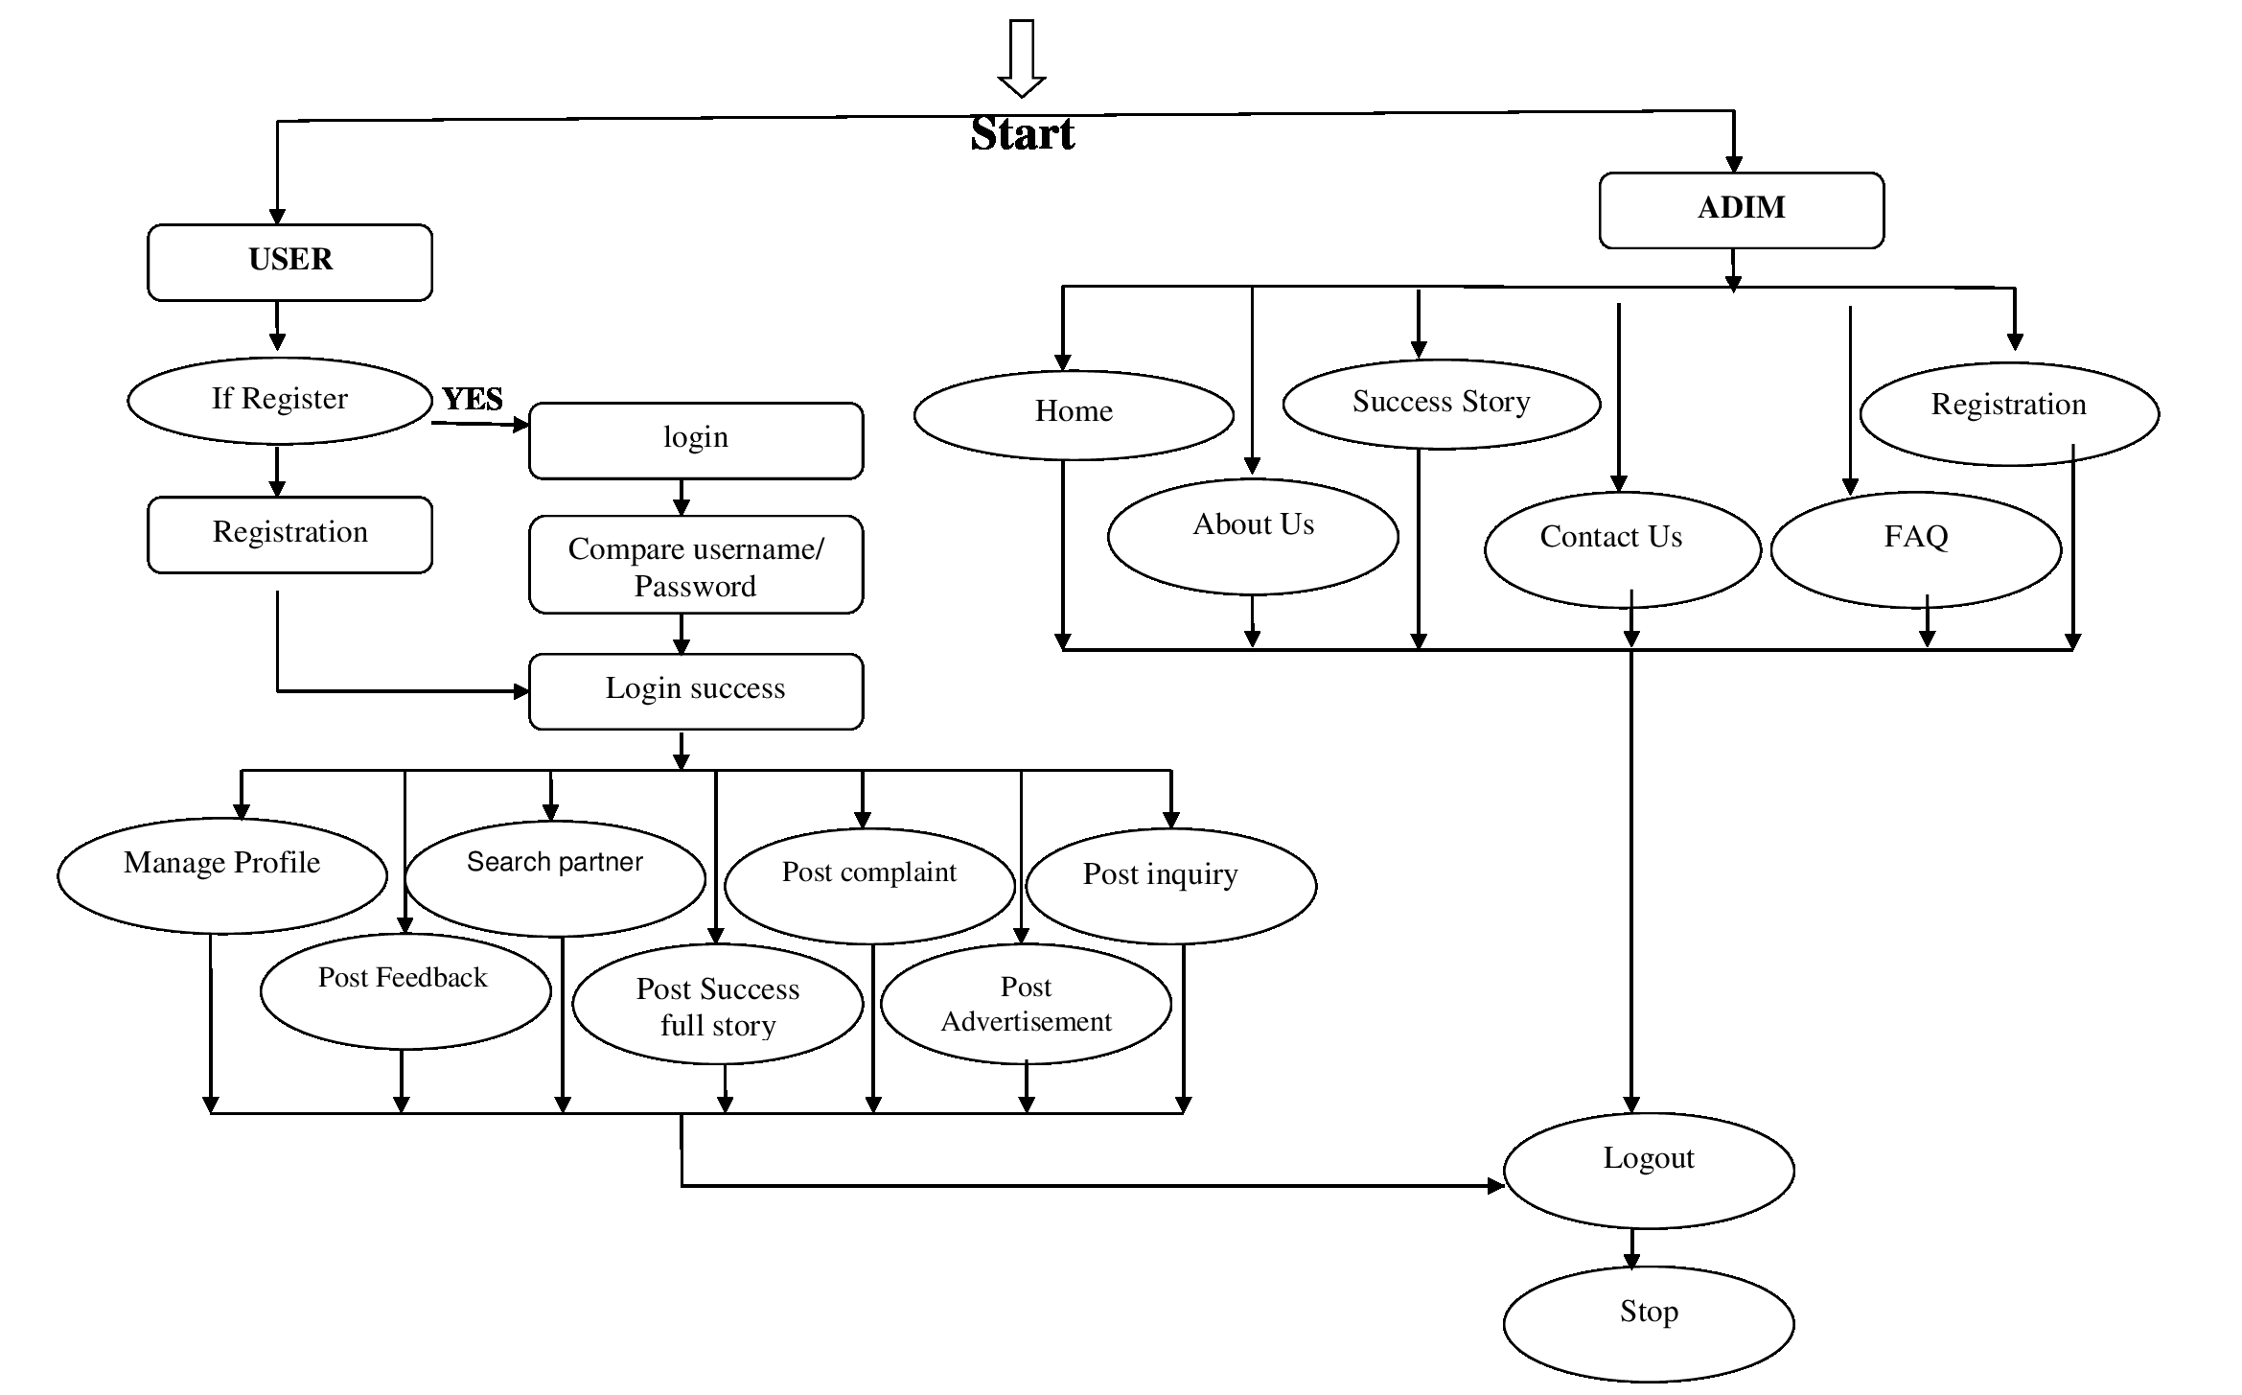
Activity diagram

Slide 29
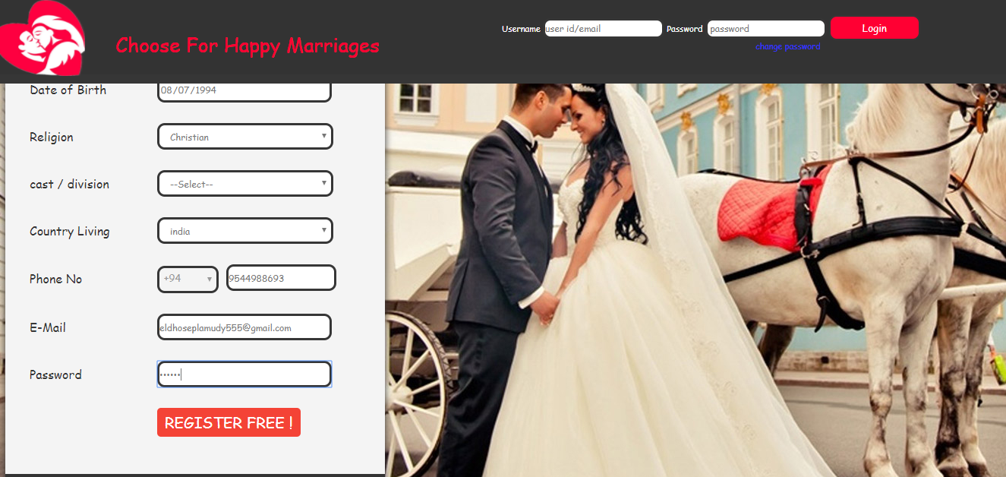
forms
User Registration page1

Slide 30
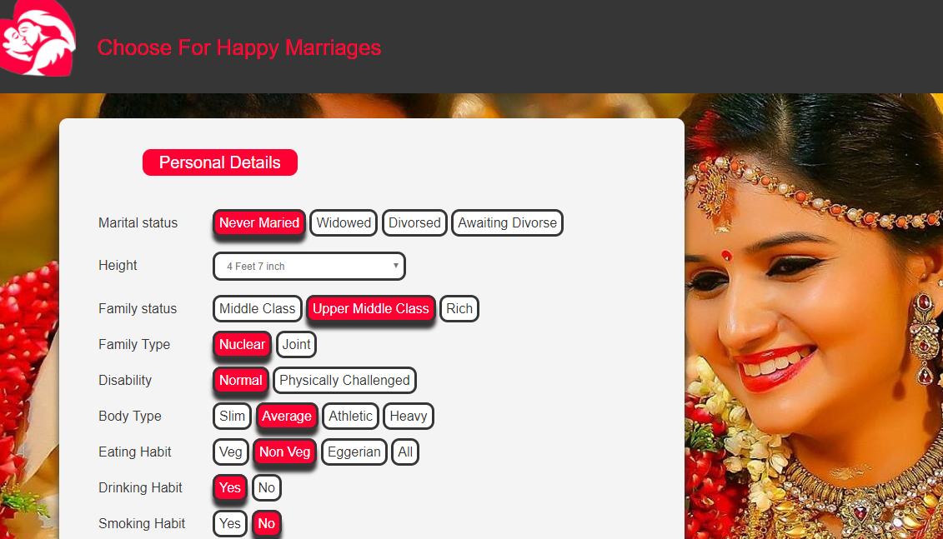
User Registration page2

Slide 31
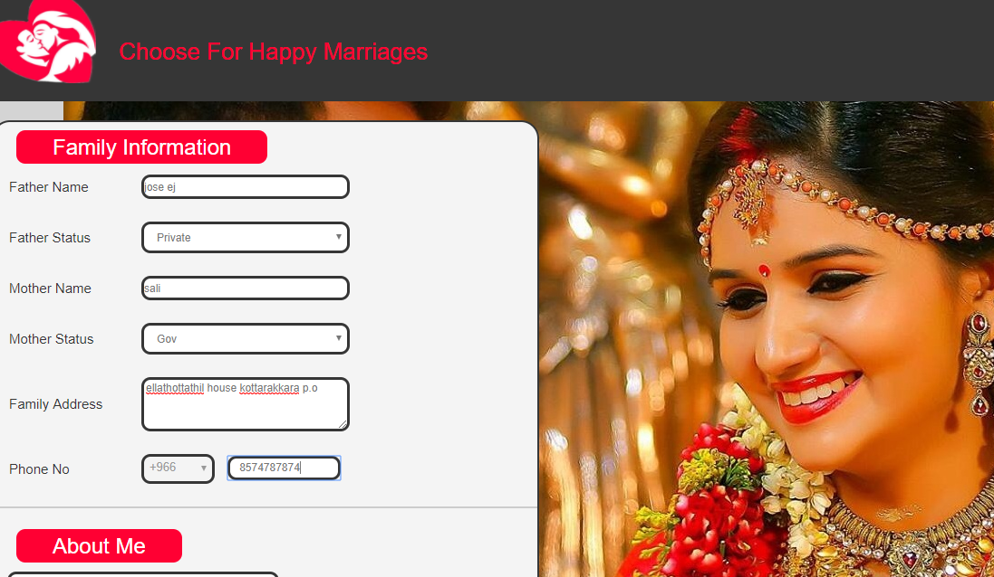
Final Registration

Slide 32
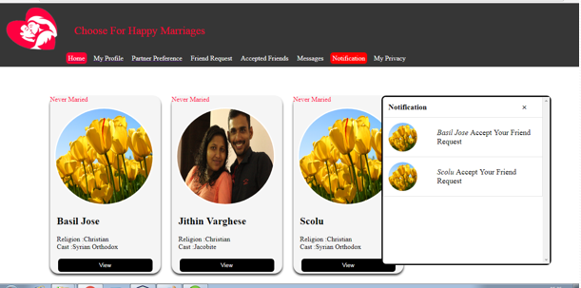
User Home

Slide 33
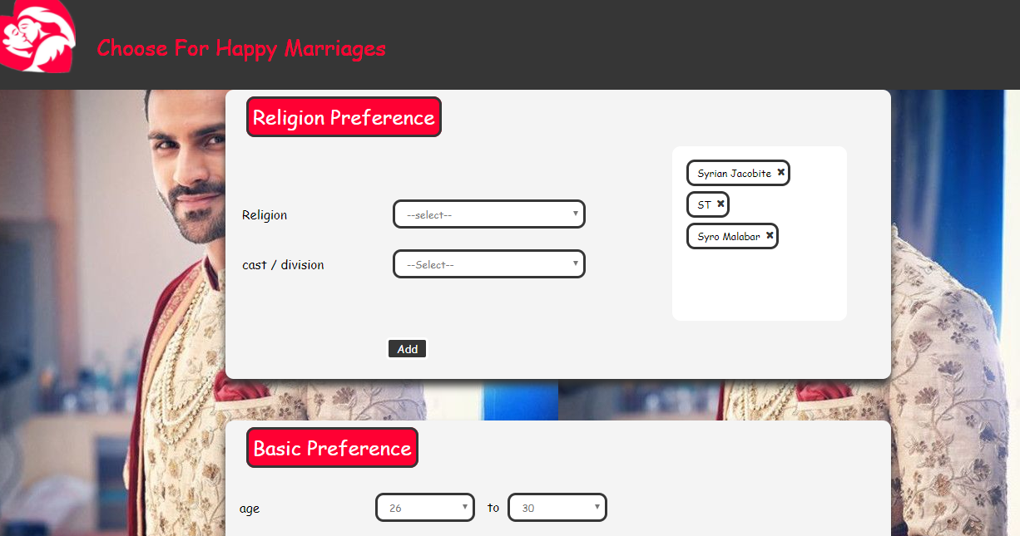
Religion Preference

Slide 34
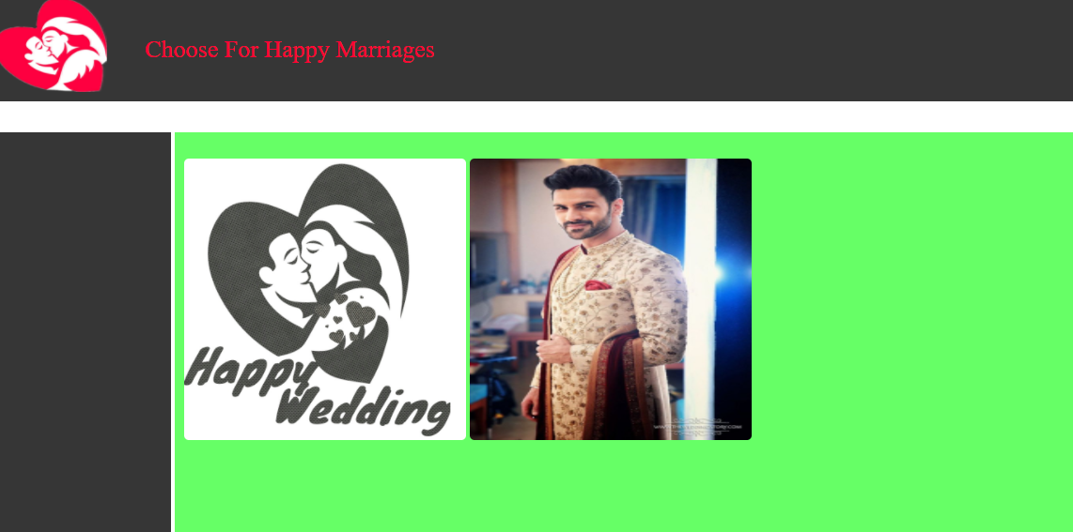
View of gallery

Slide 35
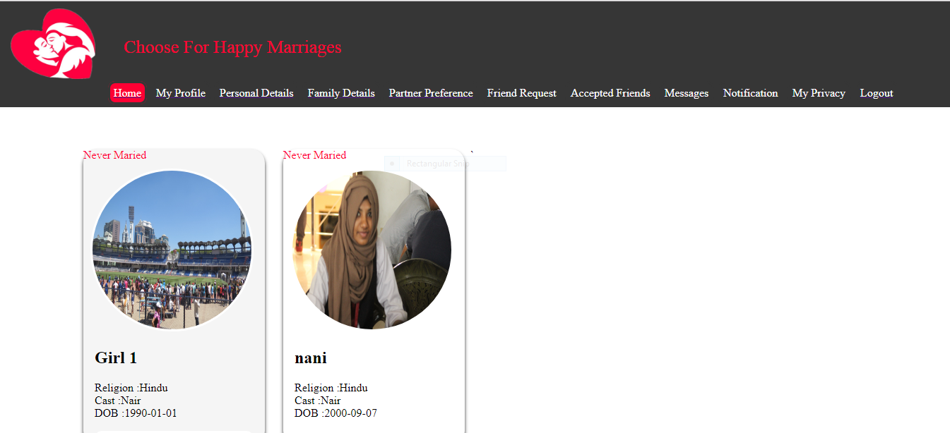

Slide 36
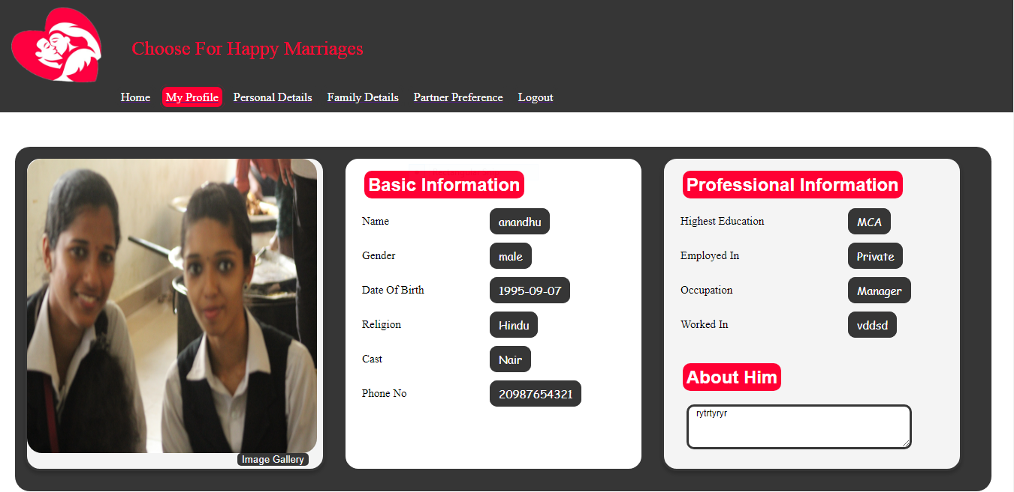

Slide 37
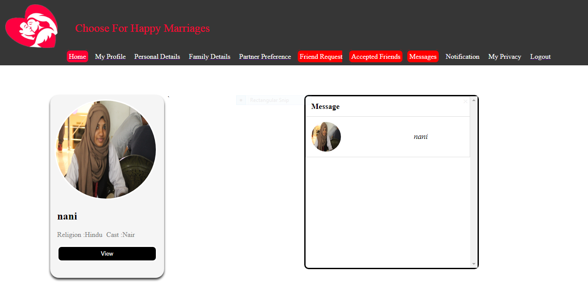

Slide 38
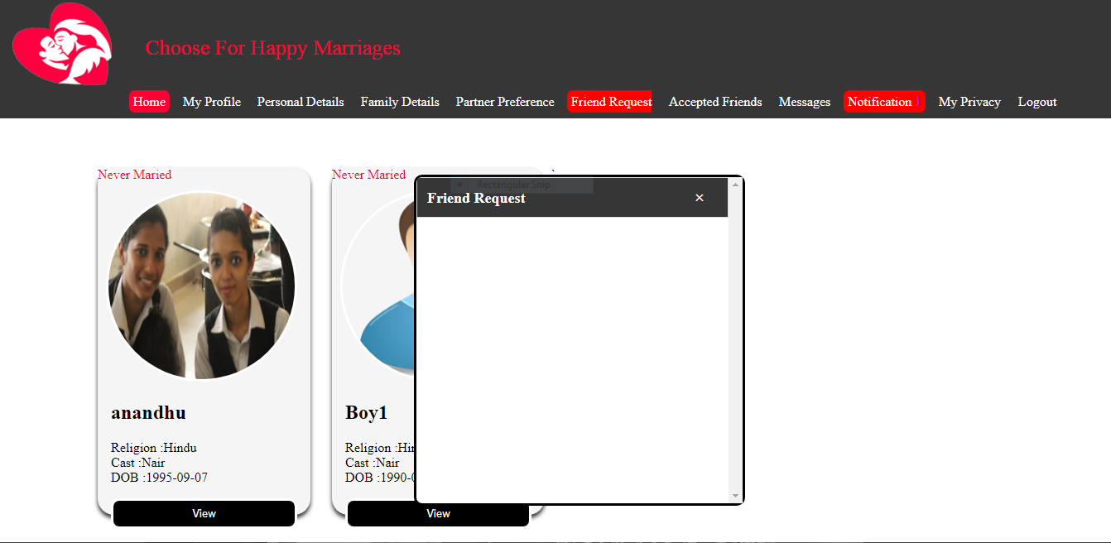

Slide 39
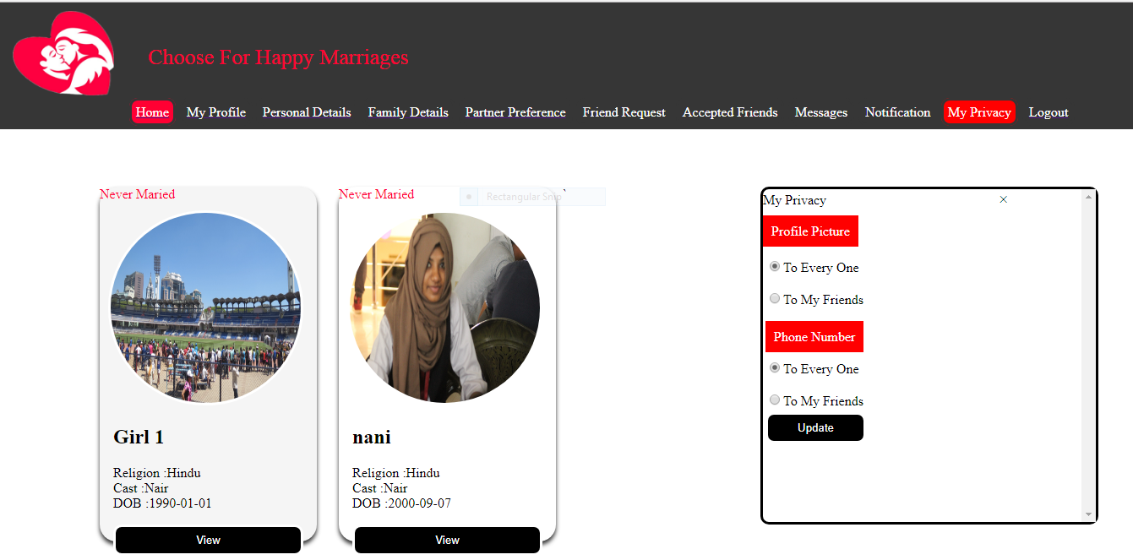

Slide 40
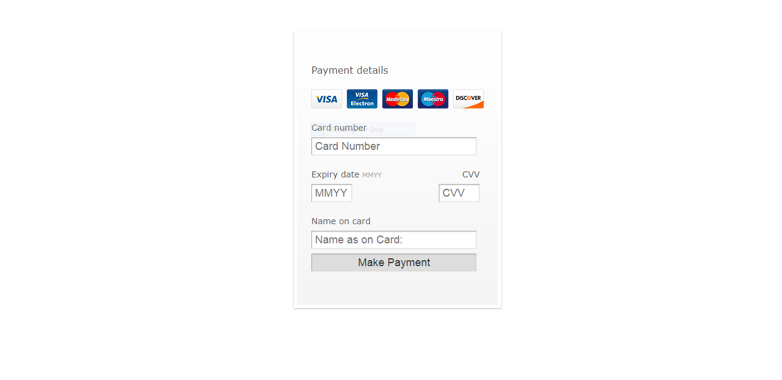

Slide 41
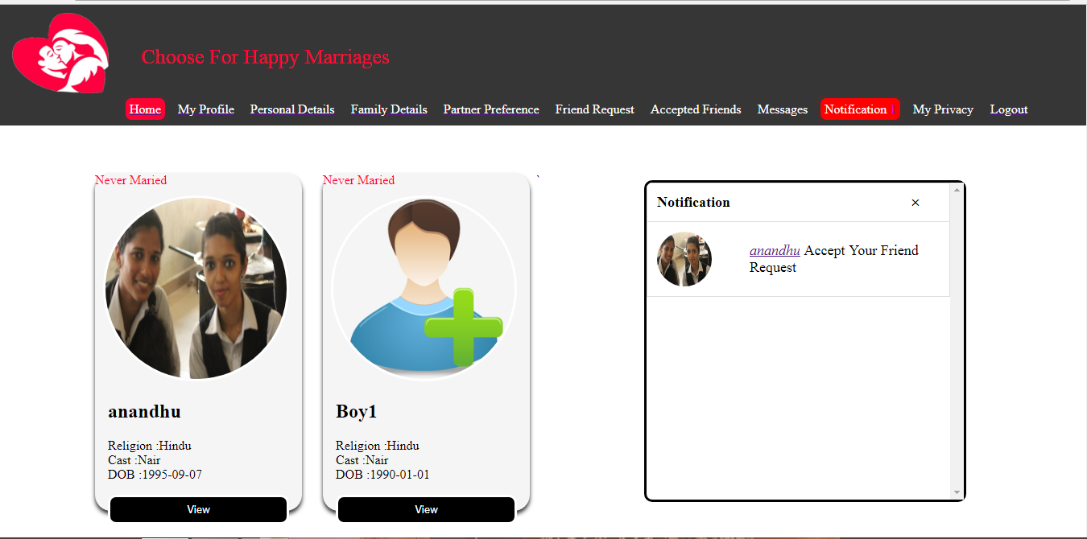

Slide 42
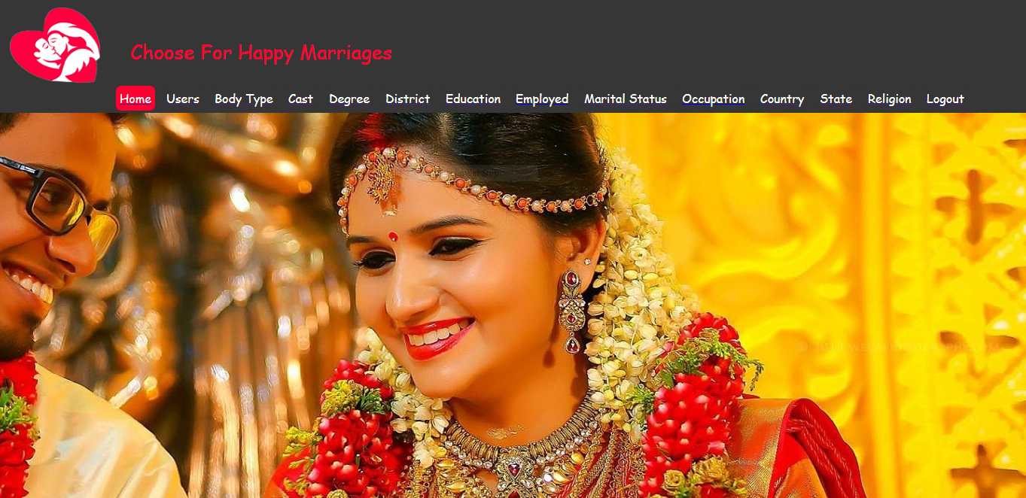
Admin Home base

Slide 43
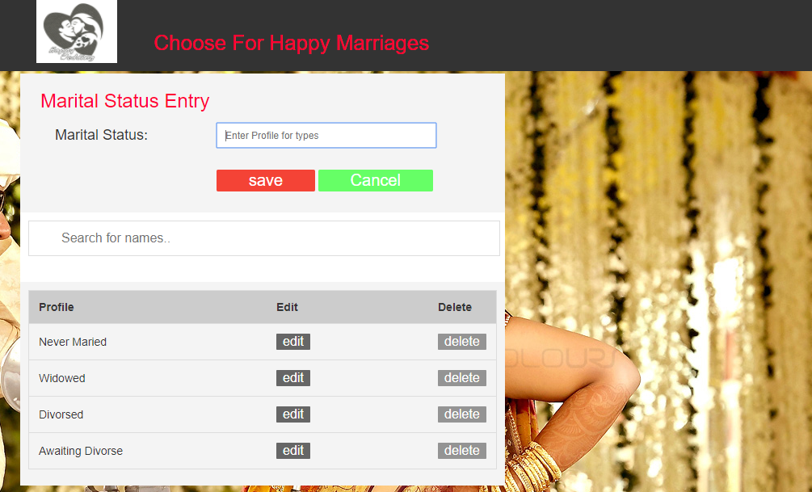

Slide 44
THANK YOU

